Slide 1
Contract Analysis Unsupervised Classification – Mid Review
Shivanshu Verma, IIT Delhi

Slide 2
Problem Statement
Unsupervised Modeling on Contracts dataset for predicting correct clause category
of the particular text paragraph.
Why Unsupervised?
Data labelling – Manual Process - time consuming
Required to be updated regularly
Risk of Overfitting and wrong prediction

Slide 3
Data Preparation
Data we have
Logical Unit
Raw data – Scanned Pdfs converted into text files using OCR
Labelled text with their respective clauses (approx. 9000 text)
Complete file was splitted into logical units which are paragraphs.
Unsupervised categories are completely unknown and may be the mixture of different classes
Notes:
Tabular – Logical unit
Data preparation

Slide 4
Approach
Logical Unit Data
Unsupervised Model
Analysis of Output Classes
Document name | Page No. | Paragraph text
---------- | -------- | -------------- --------------
Latent Dirichlet Allocation
Lda2Vec
Clustering
Deep Learning
Which output class represents which clause
How many clauses are separable?

Slide 5
Topic Modeling (LDA)
Preprocessing of Logical Units
LDA Model
Analysis of Output Topics
Word lemmatization
Stopwords and punctuation removal
Vectorization of paragraphs
Used bigrams and unigrams as the feature vectors
Hyperparameter tuning with number of topics and different parameters.
Model performance testing on labelled data set for analyzing output topics
Counted number of different clauses in different topics
Notes:
Manual stopwords list after analyzing words’ probability

Slide 6
LDA Output Results
Output results of LDA with configuration 100 topics, bigram + unigram, default stopwords

Slide 7

What does this output mean? Is it really useful?
Expectations
Results
We’ll get different topics for different clauses.
For each clauses, there will be many topics but each topic will be of different clause.
A complete mess between topics and clauses.
Unable to extract any useful information from unsupervised classification
Can we use another model over it to separate the mixture of clauses?

Slide 8
New Approach
Logical Unit Data
Unsupervised Model
Supervised
Mapping
Results
LDA + SVM
The output of unsupervised model was manually unpredictable.
Used this output as input features for supervised model and map them to defined clauses using same.
A feature vector of hundred topics probability was used as an input for support vector classification.

Slide 9
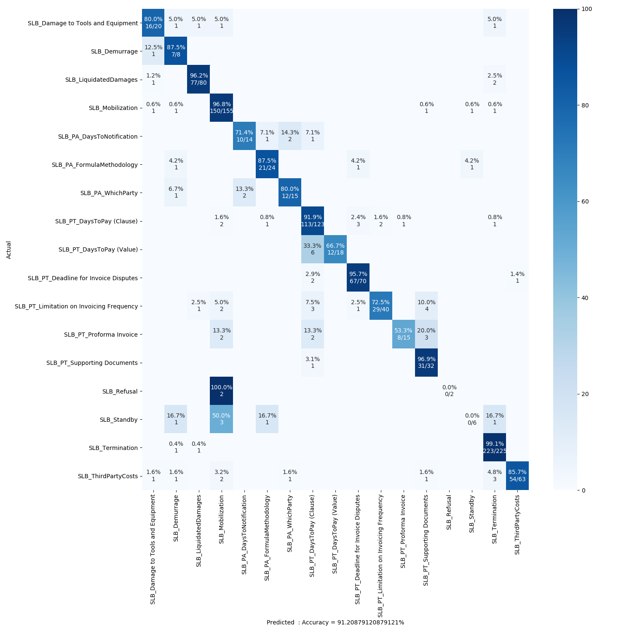
LDA + SVM Output Results
Predicted Accuracy is :
91.2 %
Confusion matrix of SVM model with LDA features as input

Slide 10
Future Work
A combination of different Unsupervised and Supervised models for higher accuracy.
Supervised Models :
Neural Networks
Random Forests
KNN
Unsupervised Models:
Lda2vec
Clustering
Semi-supervised Model

Slide 11
Thank You

